Slide 1
DATABASE MANAGEMENT SYSTEM
Team No:4A17
COURSE PROJECT
Application Development Project

Slide 2
APPLIANCE STORE MANAGEMENT SYSTEM
TEAM MEMBERS:
Anusha Raikar 01FE18BCS043
Apoorva Jinde 01FE18BCS044
Archana Badagi 01FE18BCS045
Ashwini Banagar 01FE18BCS054
Team Leader: Apoorva Jinde

Slide 3
ROLE OF TEAM MEMBERS
Responsibilities:
Anusha Raikar:
Collection of all data from the clients required for the project.
ER to relational Mapping.
Data Dictionary.
Apoorva Jinde:
Developing ER model for the management selected
ER to relational Mapping.
Object Model
Archana Badagi:
Developing ER model for the management selected.
Collection of all data from the clients required for the project.
Ashwini Banagar:
Developing ER model for the management selected.
Documentation

Slide 4
PROBLEM DESCRIPTION
We came across a problem that the shop has a huge collection of customer and supplier data which they were managing in ledgers and Excel sheets. They did not have any computerized system for now and the bill they generate was by entering the data in the cells of excel sheet. A lot of time is consumed during the process of business activity. And the customers apply for AMC should be given services which they used to mark on calendar manually hence they would mess up having the wrong number of count of the services provided to customer. So we came up with the idea of providing them a computerized system to improve the efficiency and performance of their daily business activity.

Slide 5
FUNCTIONALITY (REQUIREMENTS)
1)Details of all the customers and employees.
2) Bill Generation
3) Notification to provide service to customer who have taken up AMC(Annual Maintenance Contract)

Slide 6
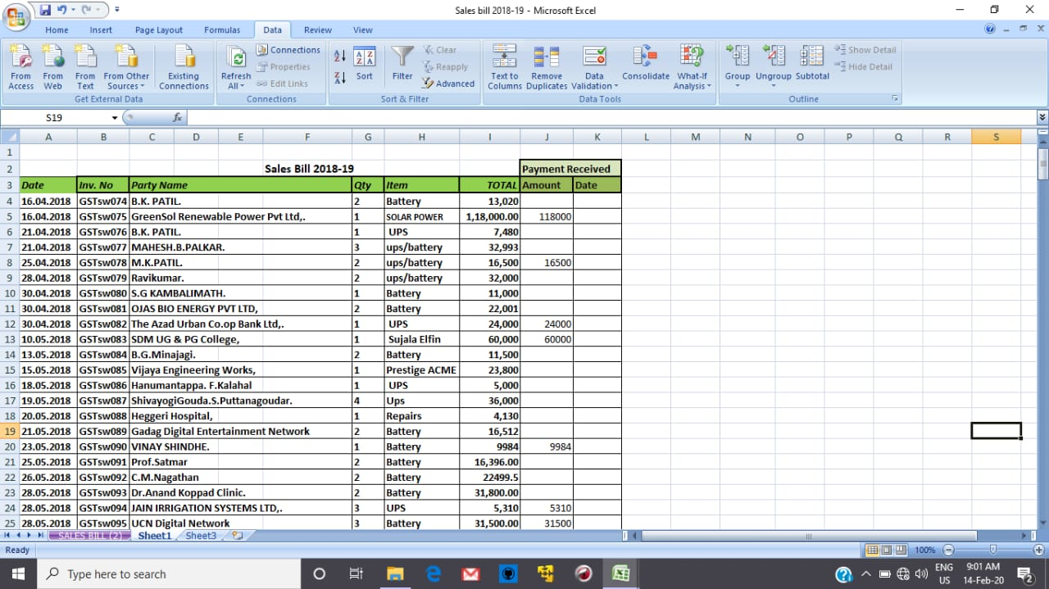
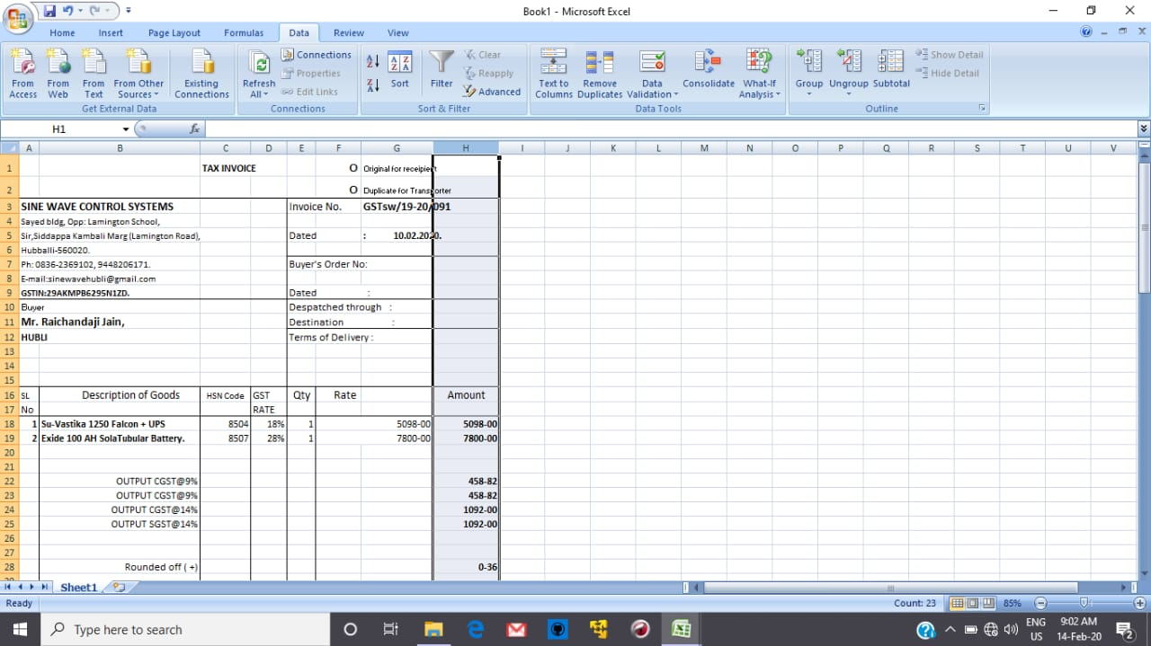
DATASET SNAPSHOTS
Records are maintained in excel files and ledgers presently.

Slide 7
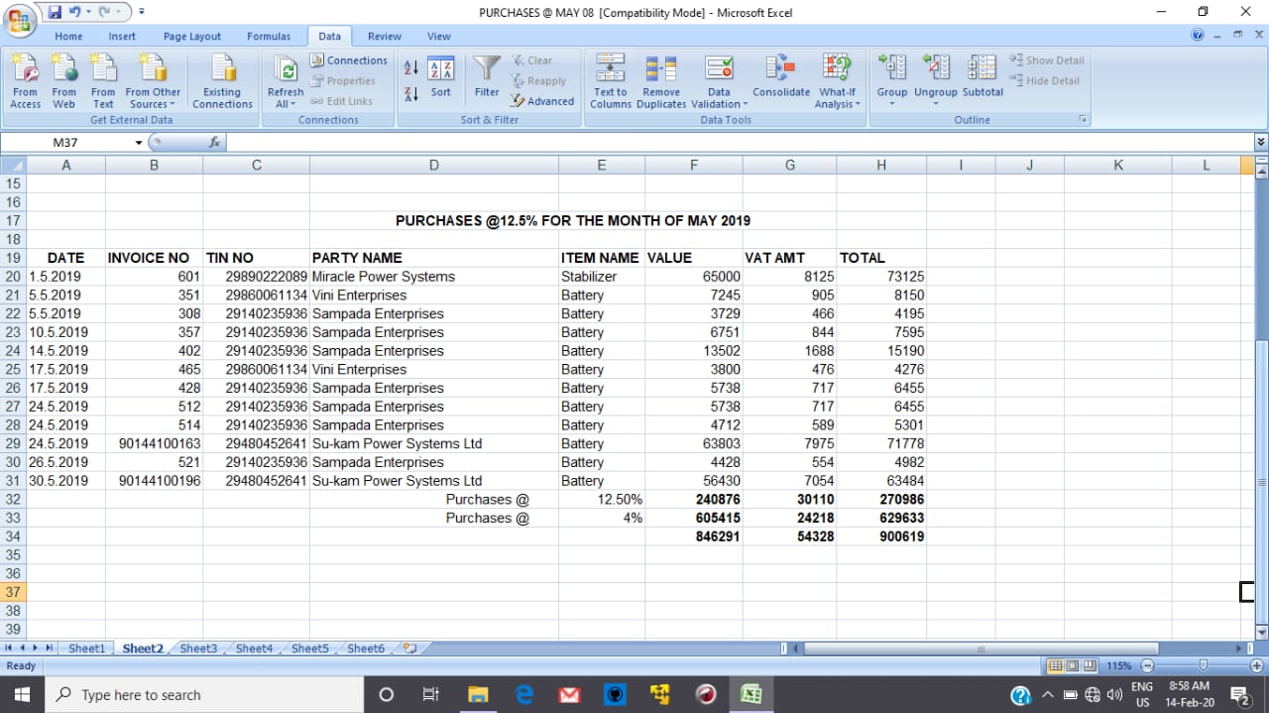
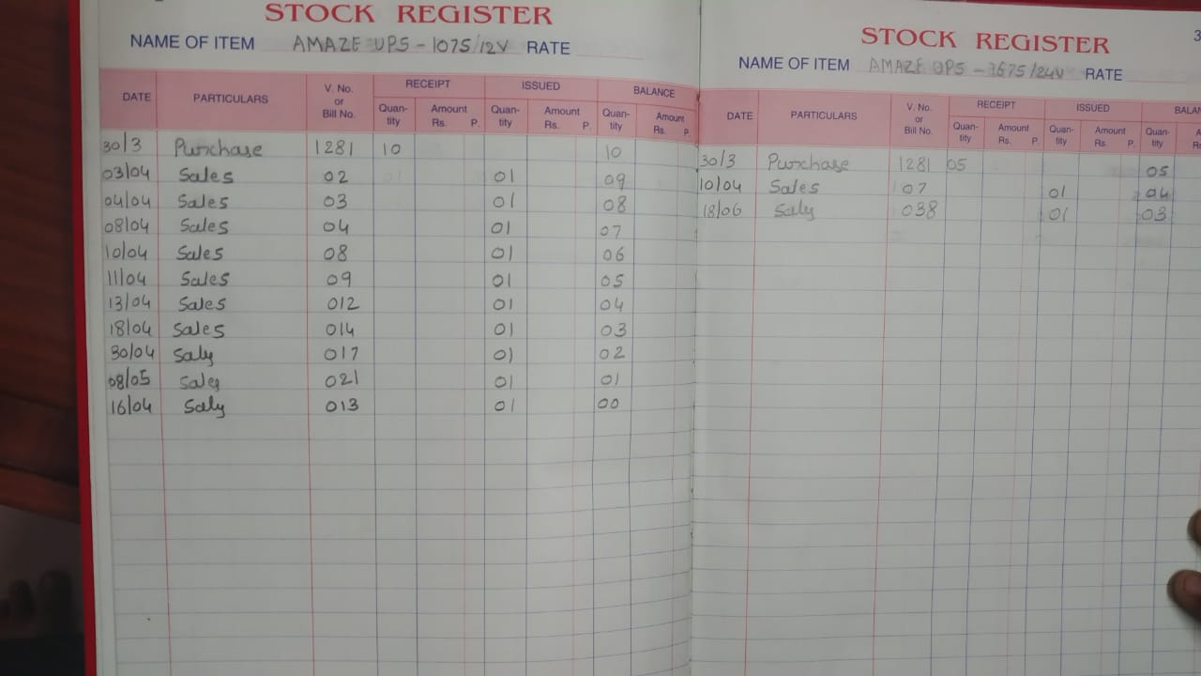
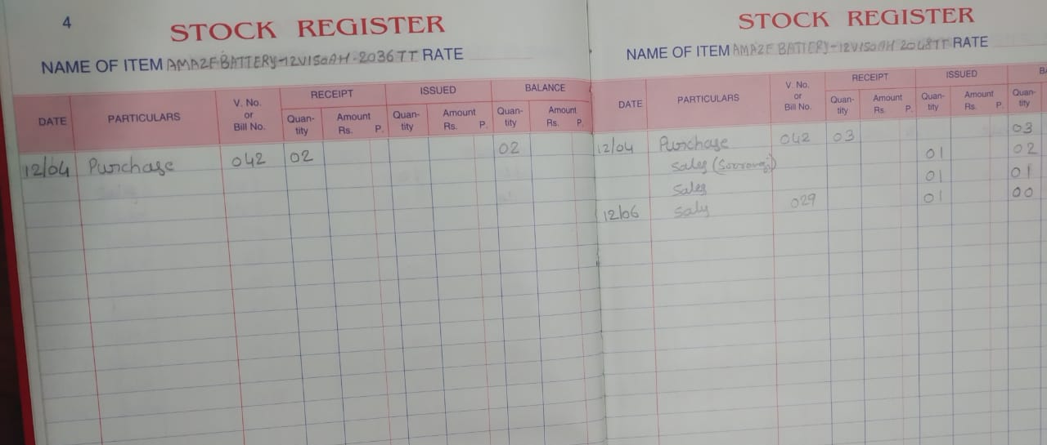

Slide 8
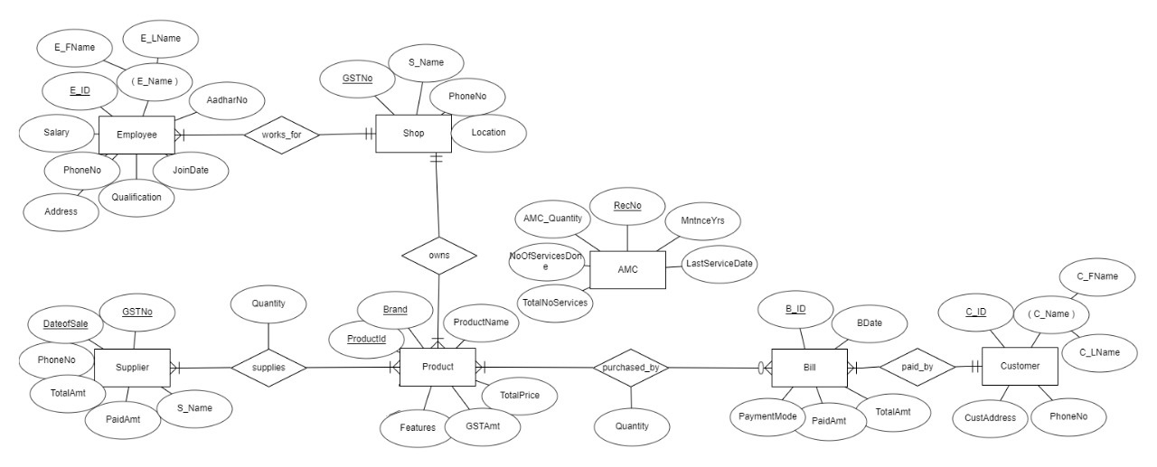
OPTIMAL ER DIAGRAM

Slide 9
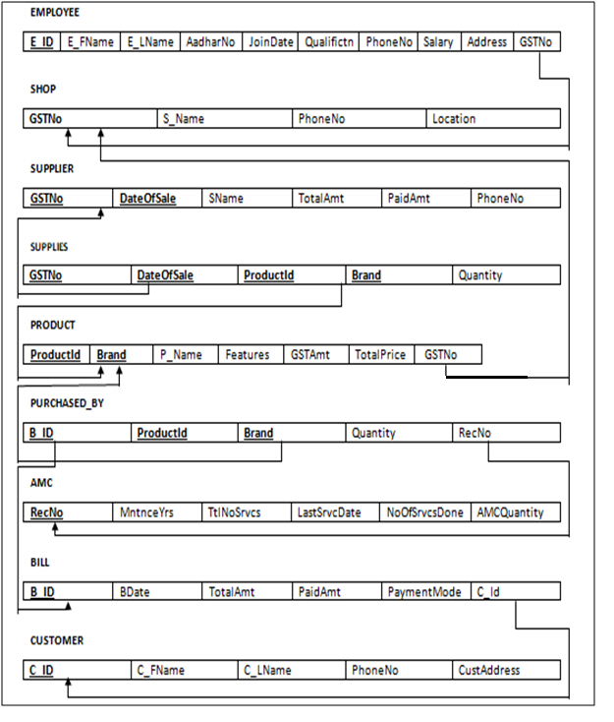
ER TO RELATIONAL MAPPING

Slide 10
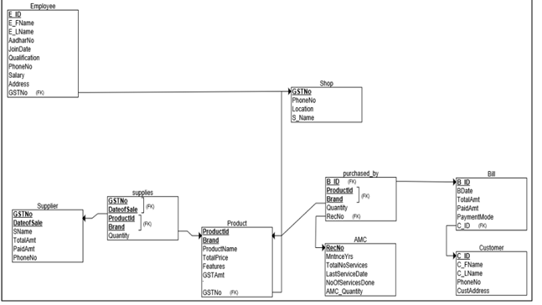
OBJECT MODEL

Slide 11
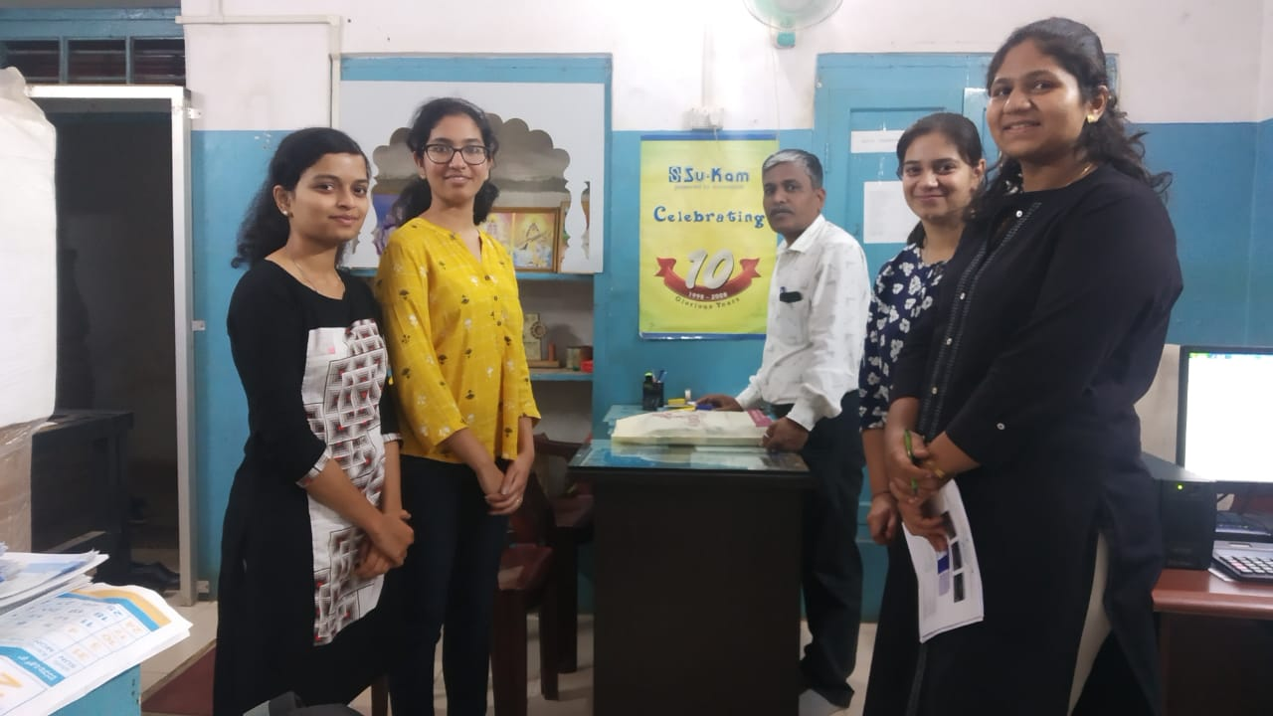
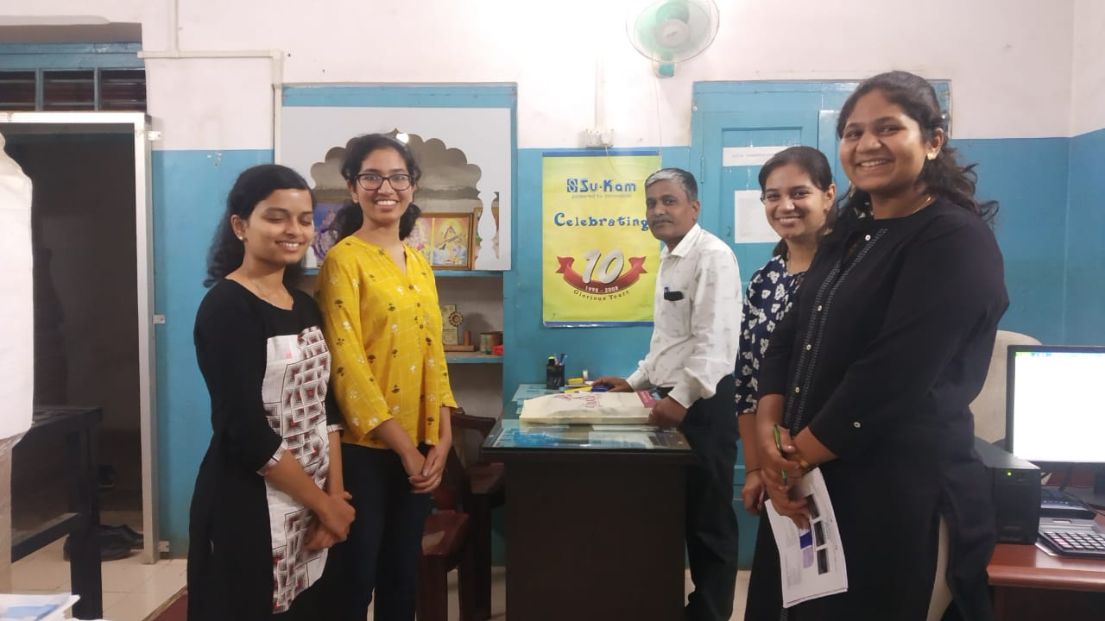
SNAPSHOT WITH THE CLIENT

Slide 12
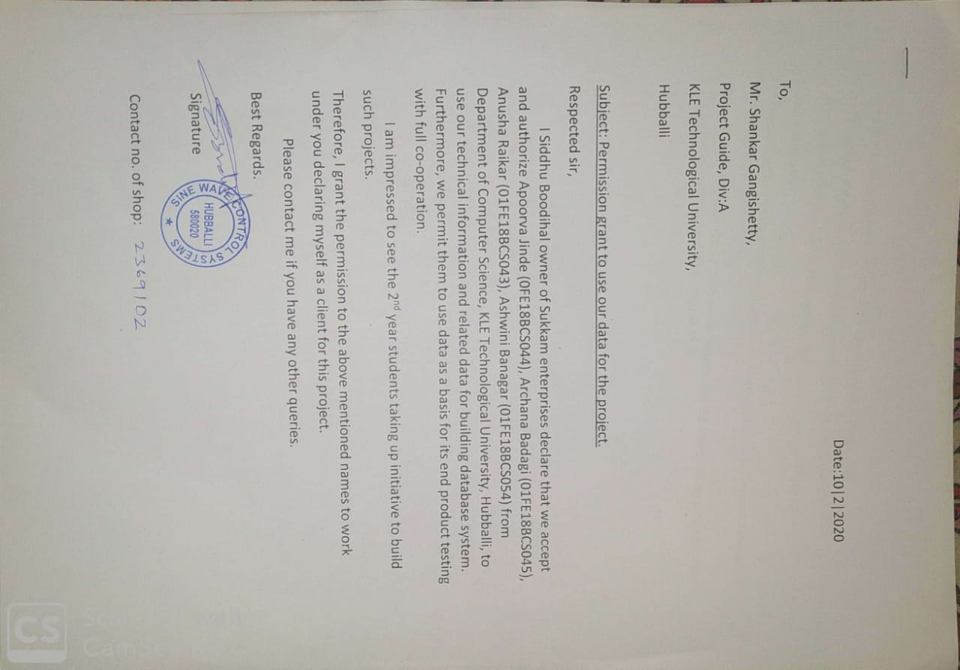
PERMISSION LETTER FROM CLIENT

Slide 13
THANK YOU
REFERENCES:
Tool used to draw the ER diagram and object diagram: https://erdplus.com

